Slide 1


E-Health Card
Presented by: Puligilla Sree Vardhan

Slide 2

Introduction
The e-health card project aims to revolutionize the healthcare system by digitizing health records, making them accessible and portable. It will streamline patient information management and enhance the quality of healthcare service delivery.

Slide 3
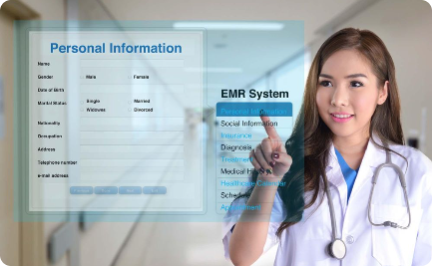
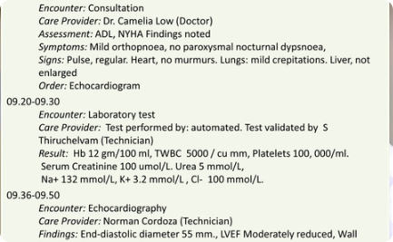
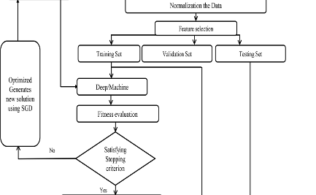
Background of the e-health card project
Digitization of Health Records
Improving Data Accessibility
Enhanced Healthcare Infrastructure
The project involves the conversion of traditional health records into electronic format, paving the way for efficient data management.
This initiative will ensure quick and easy access to patient medical history, aiding healthcare providers in making informed decisions.
Implementation of the e-health card project will contribute to the development of a sophisticated healthcare infrastructure.

Slide 4

Proposed Method
1
Research and Analysis
Thorough research and analysis will be conducted to devise an effective method for the implementation of the e-health card system.
2
System Design and Development
Expert teams will be assembled to design and develop a user-friendly and secure e-health card system.
3
Testing and Implementation
Rigorous testing and step-by-step implementation will ensure the efficiency and reliability of the proposed method.

Slide 5
Explanation of how the e-health card works
Card Registration
Data Retrieval
Security Measures
Patients' information will be registered and linked to their unique e-health cards, ensuring accurate identification and record keeping.
Healthcare providers will be able to retrieve patient data quickly and securely, leading to more efficient diagnosis and treatment.
Stringent security measures will be in place to protect the confidentiality and integrity of the stored health records.

Slide 6
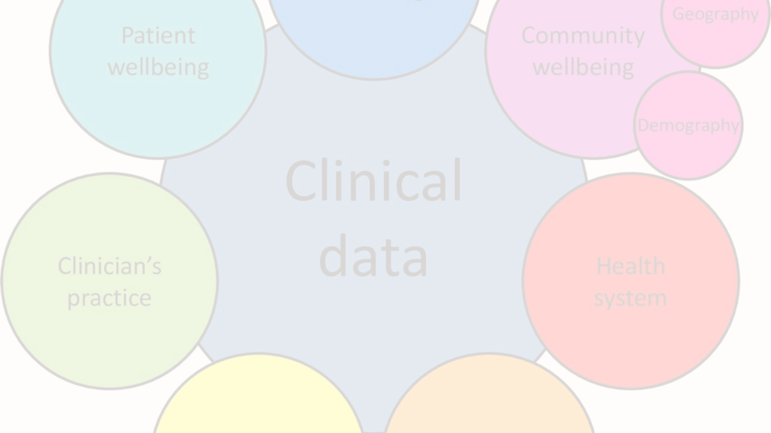
Objective
1
Streamlined Health Management
2
Enhanced Patient Care
3
Efficient Data Sharing
Improving patient care by providing healthcare providers with quick access to accurate medical records is a key focus of the project.
The e-health card project aims to facilitate seamless and secure sharing of patient information across healthcare facilities.
The primary objective is to streamline the management of health records through a unified and accessible digital platform.

Slide 7

Hardware and Software Requirements
The E-Health Card project requires specific hardware and software components to ensure its successful implementation and operation.
System: Pentium IV 2.4 GHz
Hard Disk: 40 GB
Floppy Drive: 1.44 Mb
Monitor: 15 VGA Color
Mouse: Logitech.
Ram: 512 MB
Operating system: Windows 8Professional
Coding Language: Java
IDE: Eclipse
Framework: Windows Builder

Slide 8
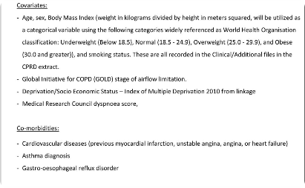


Benefits and advantages of implementing the e-health card system
Enhanced Patient Experience
Operational Efficiency
Widespread Accessibility
Improves administrative efficiency, reduces paperwork, and simplifies the process of managing patient data.
Patients can access their medical records easily, leading to greater empowerment and active involvement in their healthcare journey.
Increases accessibility to quality healthcare services, particularly in remote or underserved areas.

Slide 9
Future Scope
Technology Integration
Expanded Service Offerings
Global Integration
Constant technological advancement will be integrated to further enhance the capabilities and features of the e-health card system.
The project will continue to evolve, incorporating additional services to cater to diverse healthcare requirements.
Efforts will be made to align the e-health card system with global healthcare standards and interoperability frameworks.

Slide 10

Conclusion
1
Transformative Impact
2
Sustainability and Scalability
The e-health card project promises to bring about a significant positive transformation in the healthcare industry.
Designed for long-term sustainability and scalability to accommodate future healthcare demands and advancements.
3
Improved Healthcare Access
Ultimately aiming to enhance healthcare accessibility, quality, and efficiency for individuals and communities.

Slide 11
Thank
You

